Slide 1
Laser Light Security System
Presented By:
Chirag Kumar(2020BtechCSE022)
Koppunoor Bhanu Prakash Reddy(2020BtechCSE041)

Slide 2
Table of Contents
1
2
3
4
Introduction
Components Used
Circuit Diagram
Snaps

Slide 3
What is Laser Security System??
A security and alarm system that uses laser light and a light sensor is known as a laser-based security system. Our houses, offices, banks, lockers, and other valuables are all protected by security systems from intruders and unauthorised entry. There are various sorts of security systems available, with laser-based security systems being one of the most significant and effective.

Slide 4

Components Used
MSP430 Microprocessor
Breadboard
Jumper Wires
Resistors
LDR Sensor
LCD
Potentiometer
Hook-Up Wires
Buzzer (Alarm)
Laser Light
LED

Slide 5
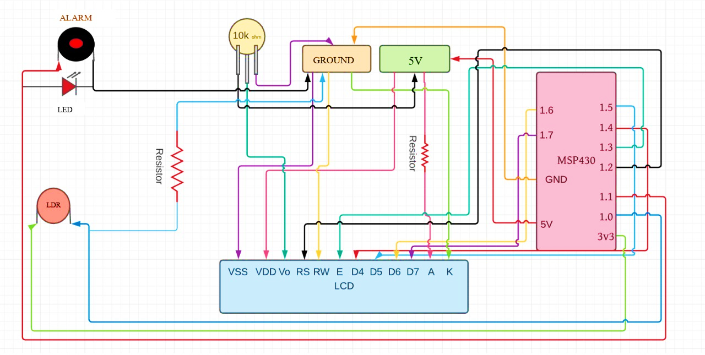
Circuit Diagram

Slide 6
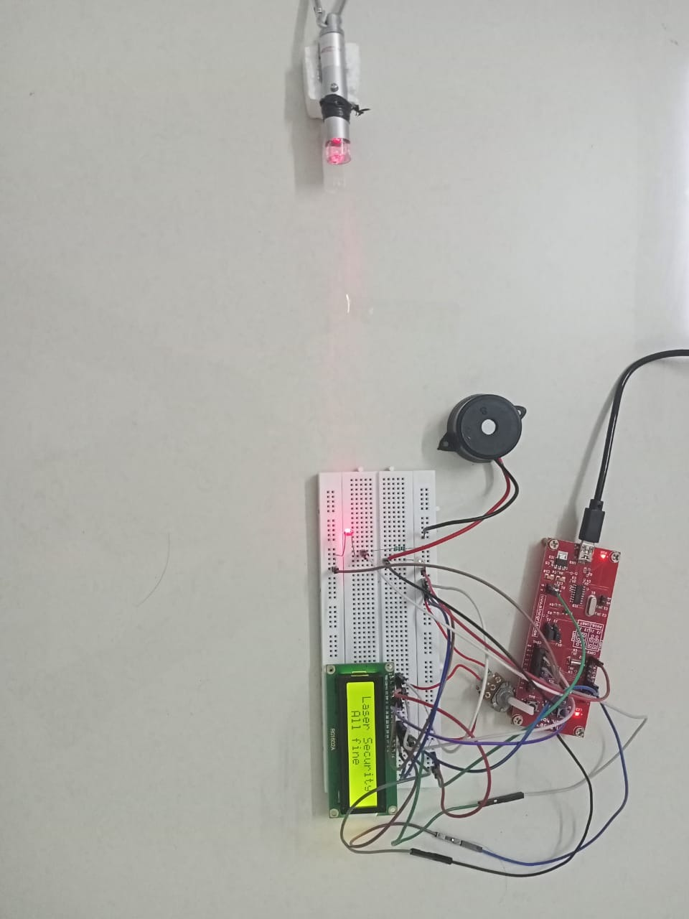
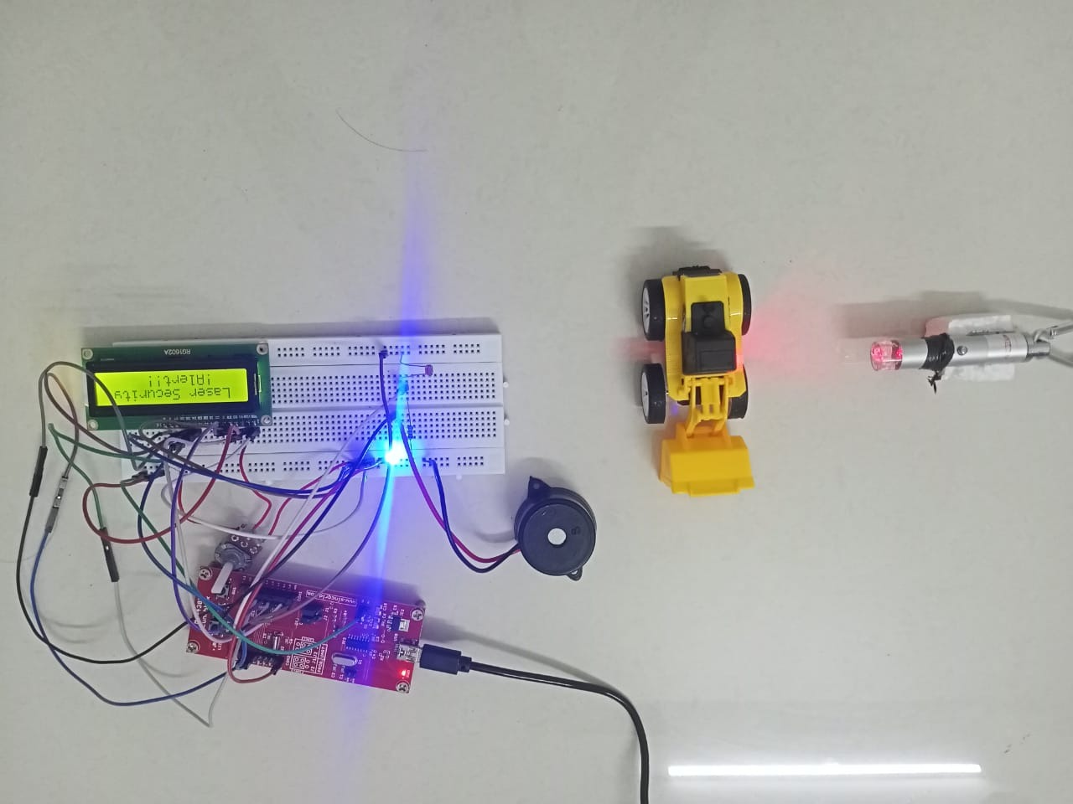
SNAPS

Slide 7
THANKS

